Slide 1
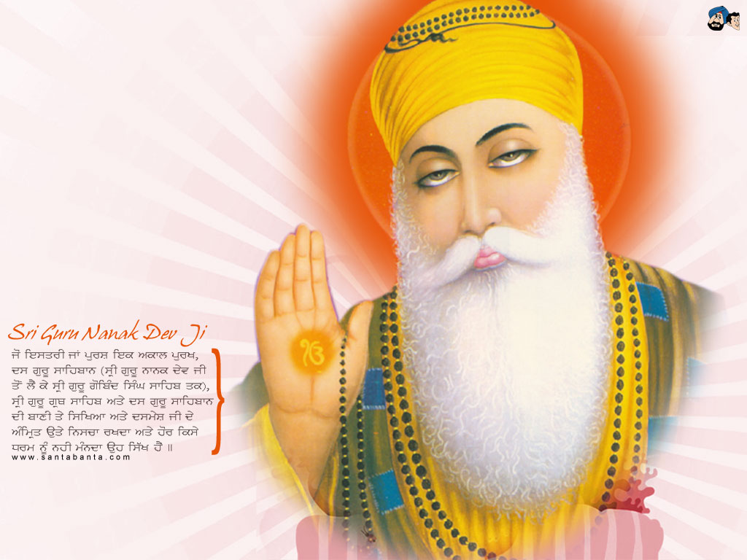
WITH THE BLESSINGS OF ALMIGHTY TODAY WE ARE STANDING HERE

Slide 2
COMPUTER GUIDED IMPLANT SURGERY
11 IMPLANTS INSERTED IN MINIMUM TIME OF ABOUT 1 HOUR
6 IMPLANTS IN MAXILLA
5 IMPLANTS IN MANDIBLE

Slide 3
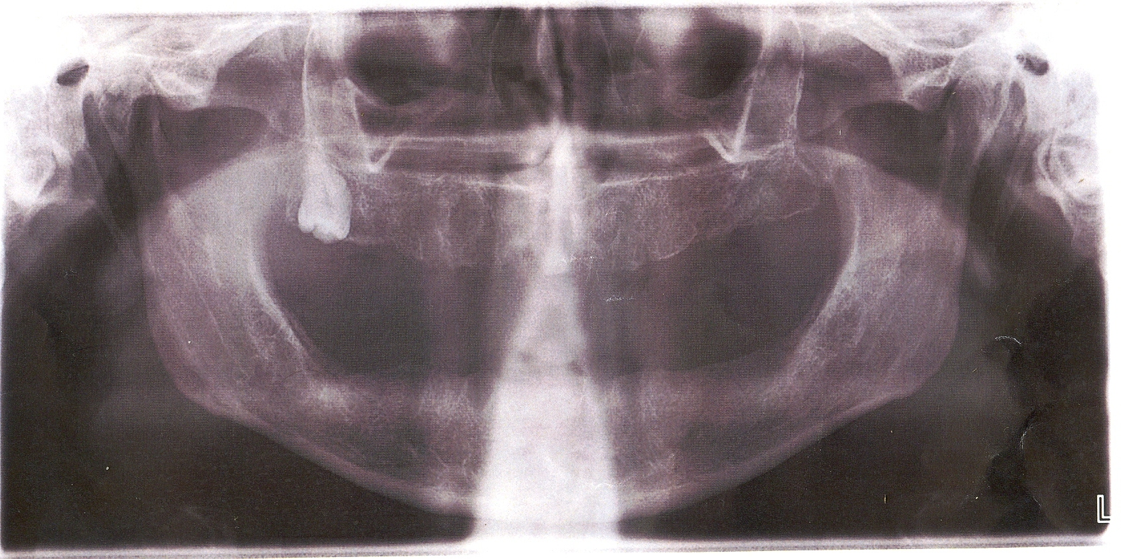
OPG BEFORE SURGERY

Slide 4
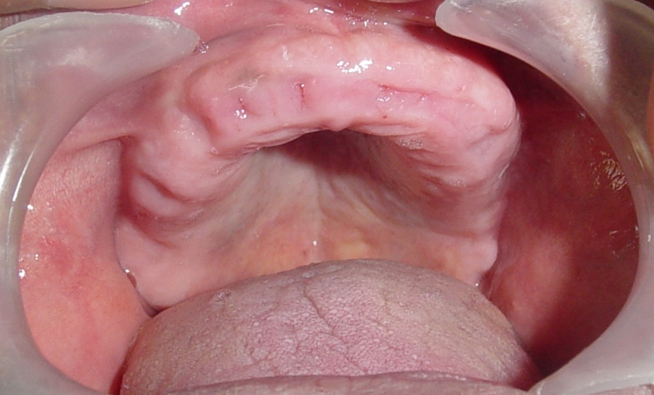
MAXILLA BEFORE SURGERY

Slide 5
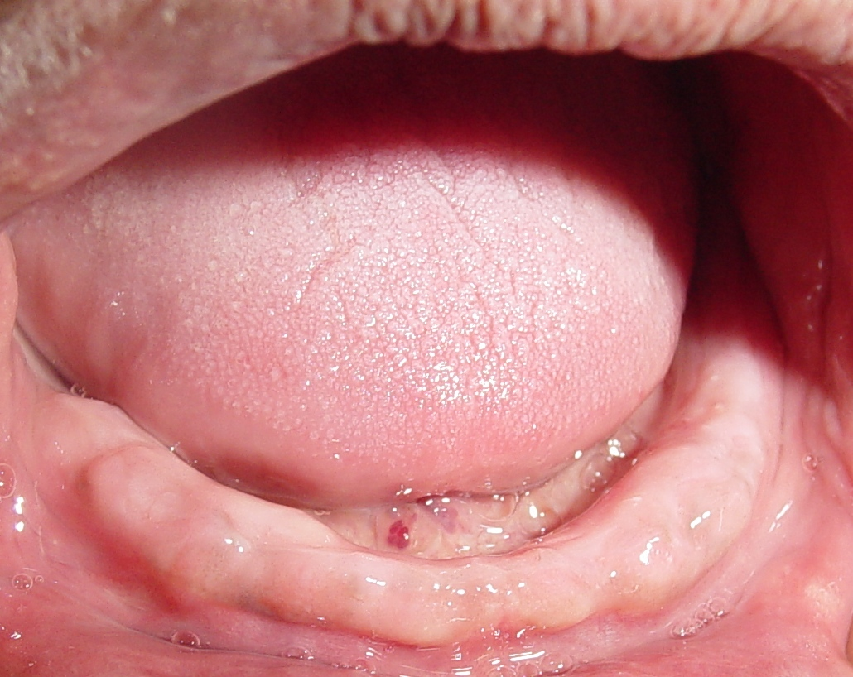
MANDIBLE BEFORE SURGERY

Slide 6
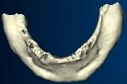
3D OF MANDIBLE

Slide 7
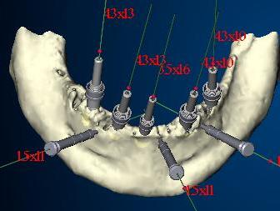
PLANNING OF MANDIBLE

Slide 8
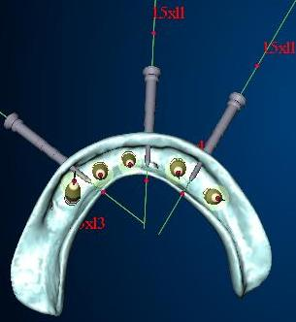
MANDIBLE PLANING

Slide 9
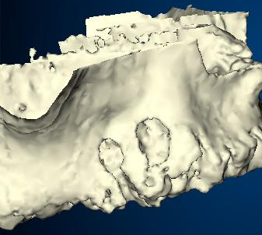
3 D OF MAXILLA

Slide 10
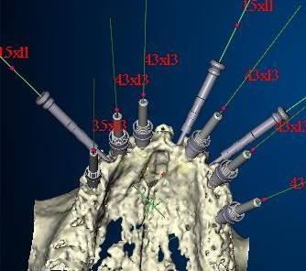
MAXILLA -PLANNING

Slide 11
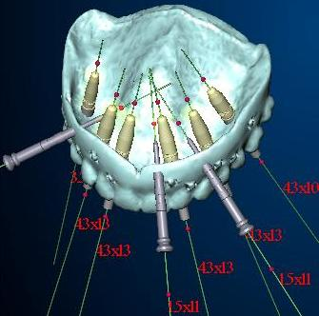
MAXILLA -PLANNING

Slide 12
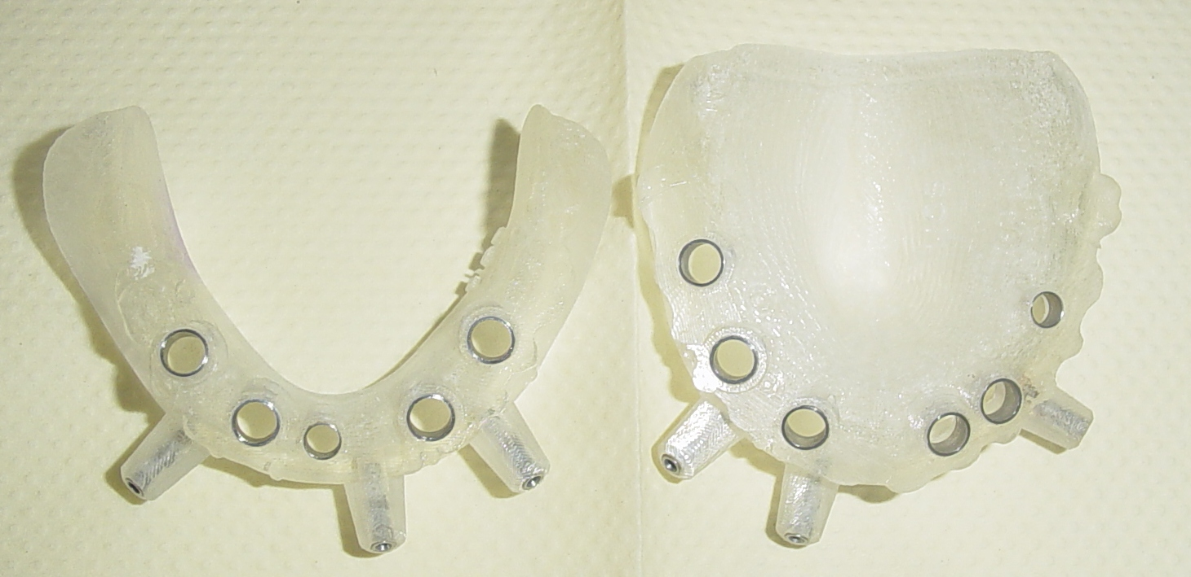
SURGICAL TEMPLATE MANDIBLE/MAXILLA

Slide 13
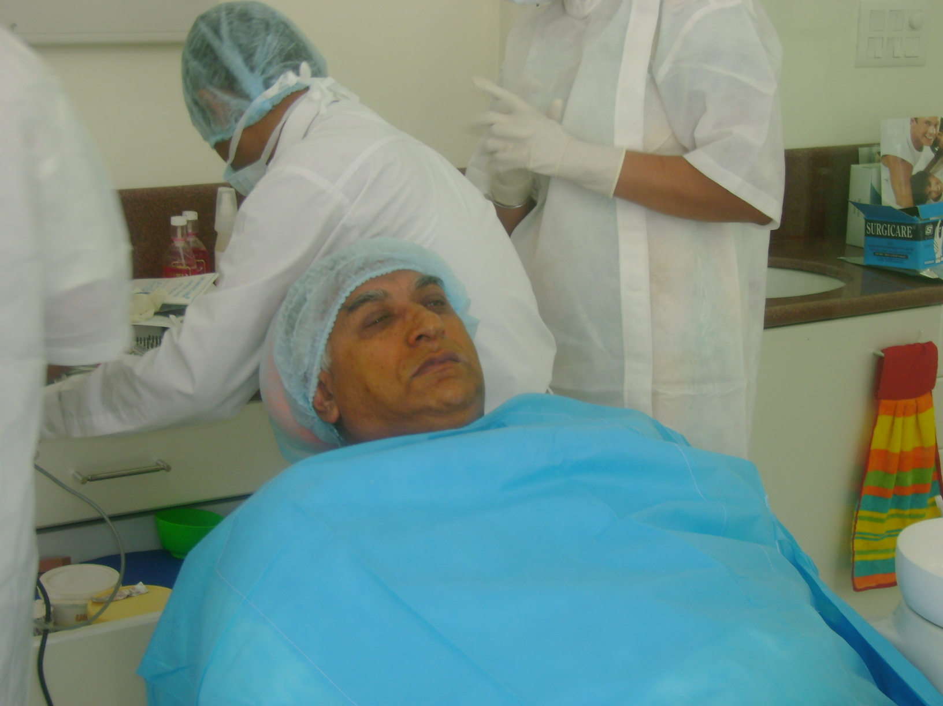
PATIENT PREPRATION

Slide 14
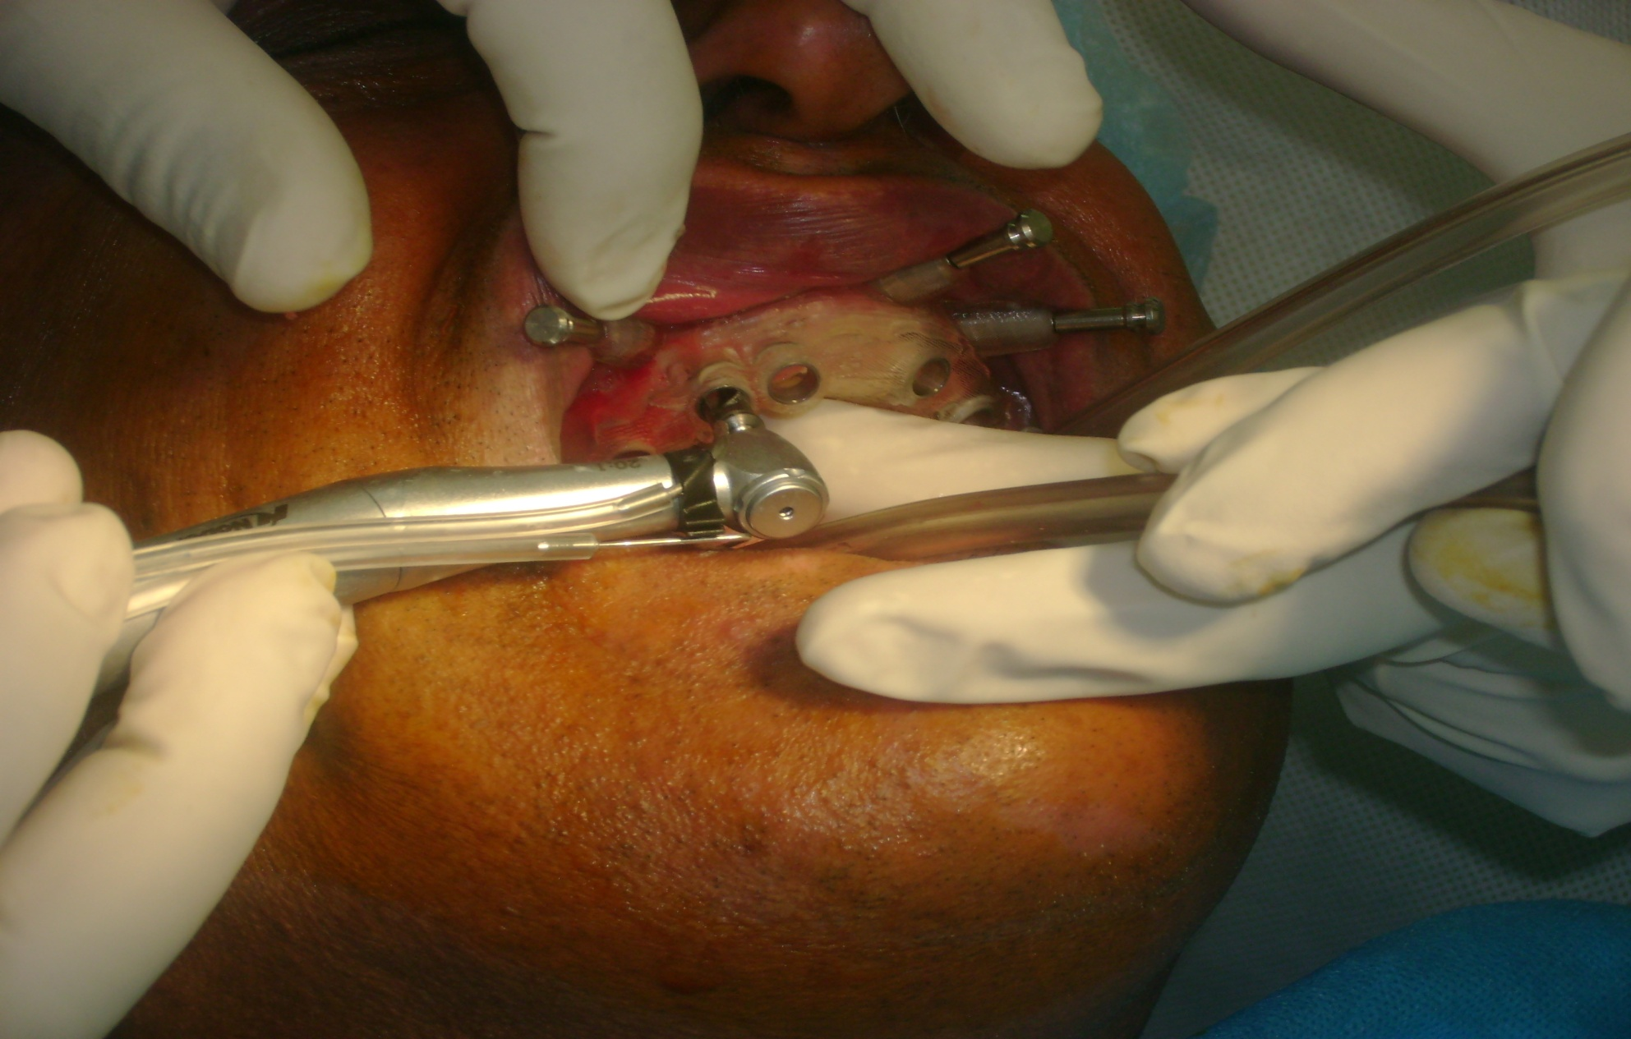
STARTED WITH MAXILLA 6 IMPLANTS PLACE IN MAXILLA

Slide 15
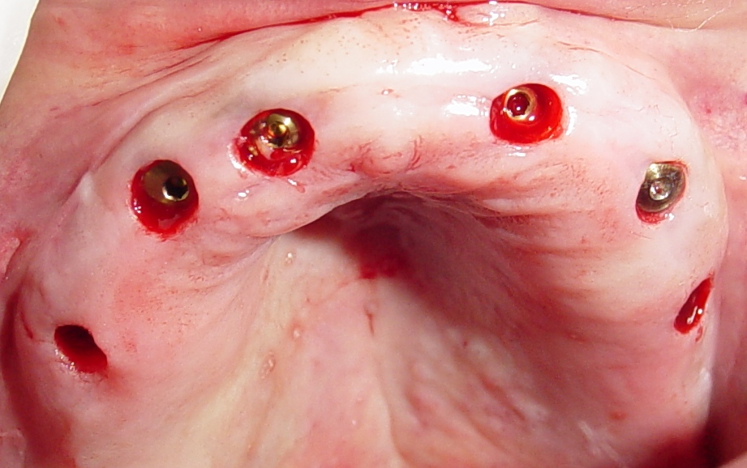
Installed 6 implants in maxilla without blade and suture

Slide 16
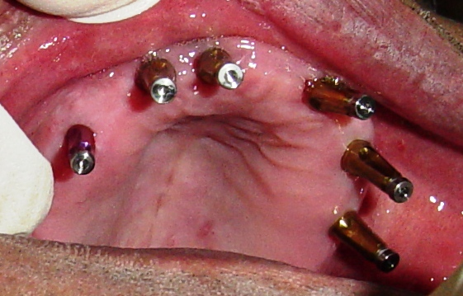
Impression copings

Slide 17
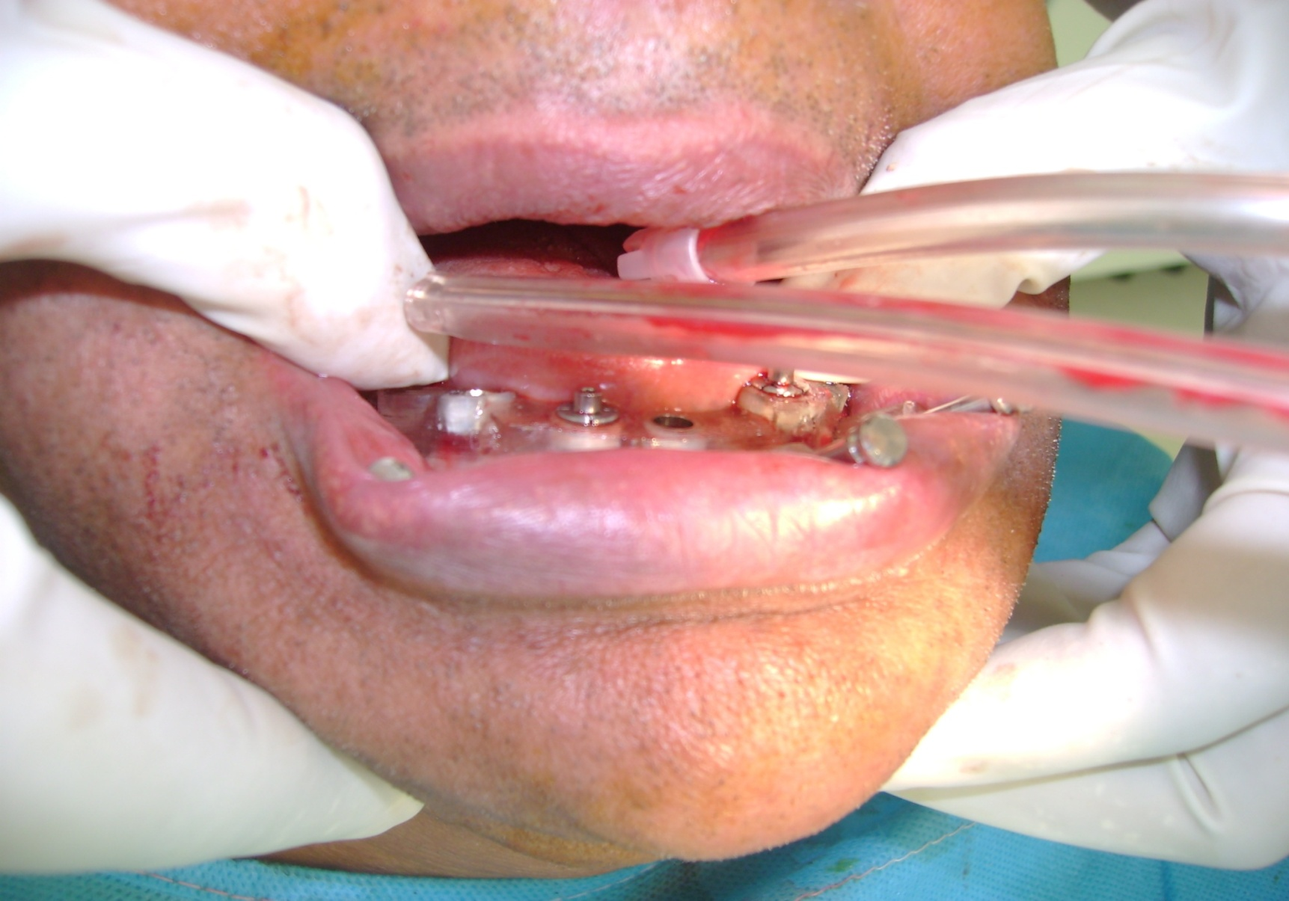
MANDIBLE 5 IMPLANTS PLACED IN MANDIBLE

Slide 18
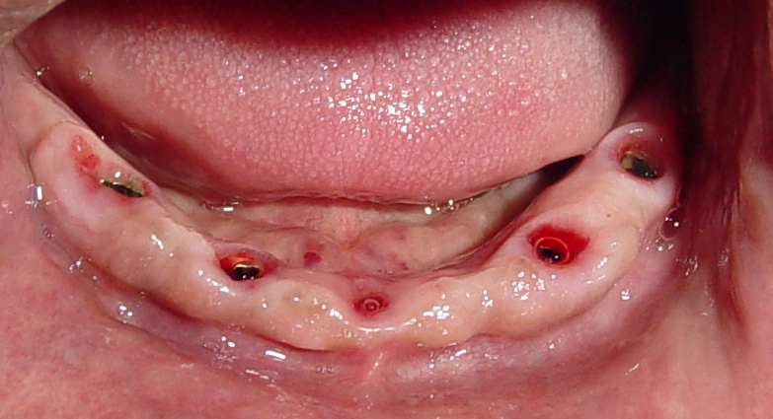
Installed 5 implants in mandible without blade and suture

Slide 19
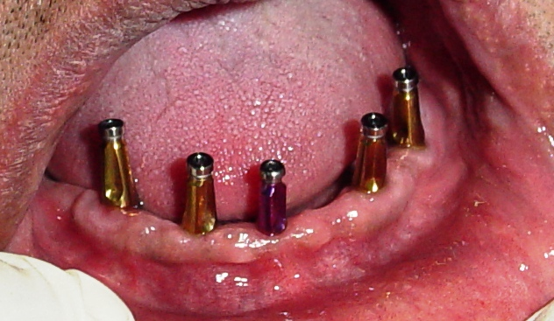
Impression copings

Slide 20
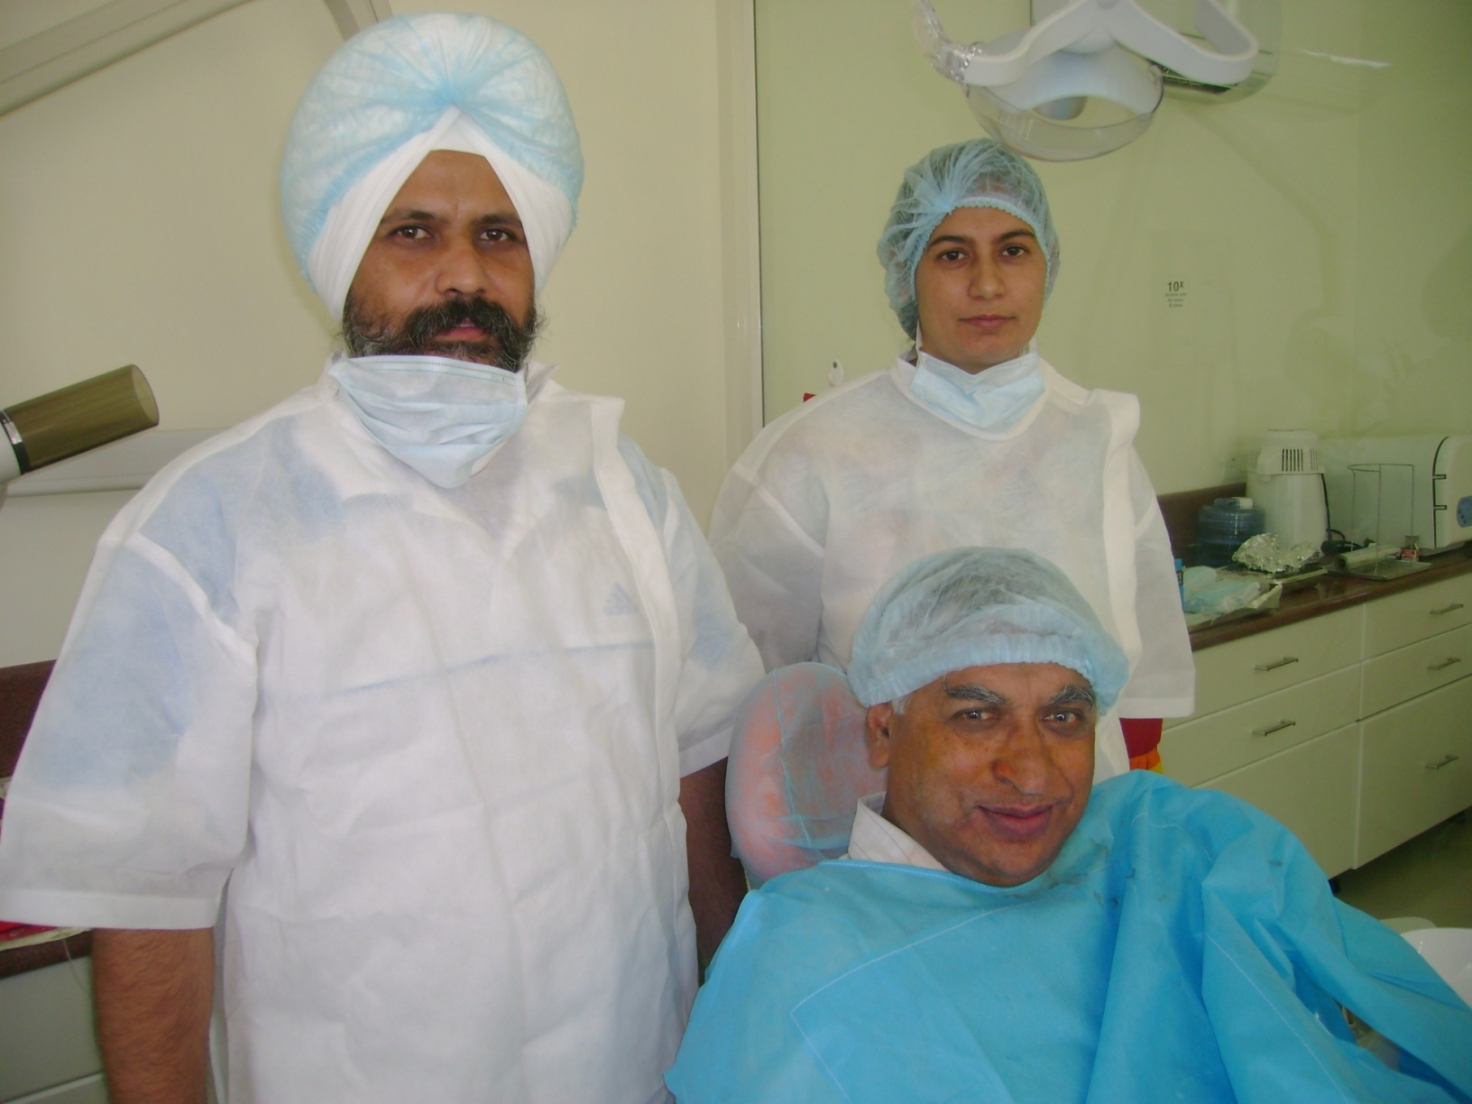
JUST AFTER FINISHING SURGERY

Slide 21
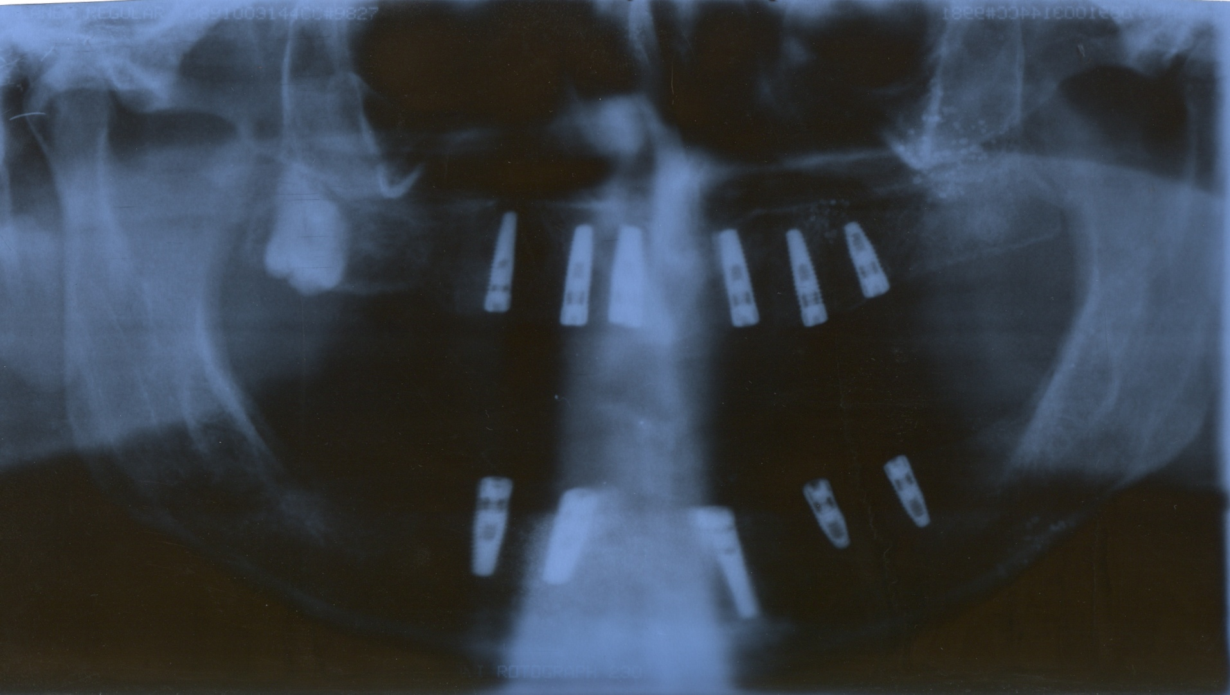
OPG AFTER SURGERY

Slide 22
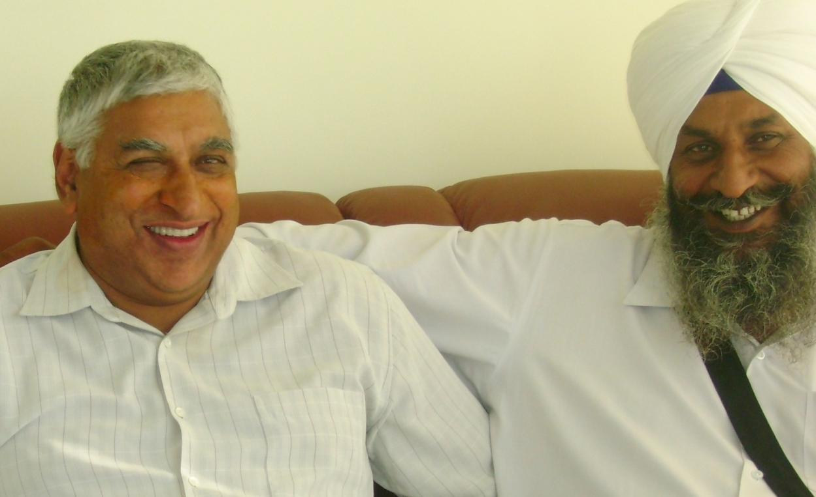
Happy patient

Slide 23

Surgeons Dr A S cheema Dr R cheema with patient

Slide 24
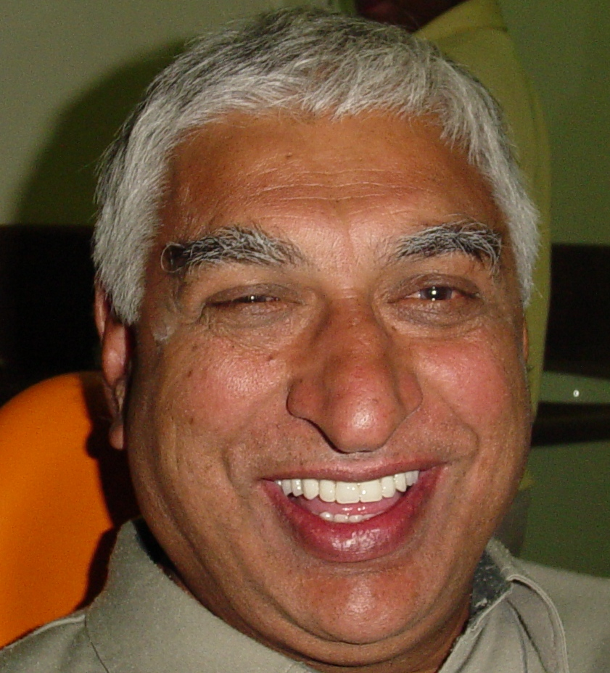
Patient with procera implant bridge permanent fixed teeth

Slide 25
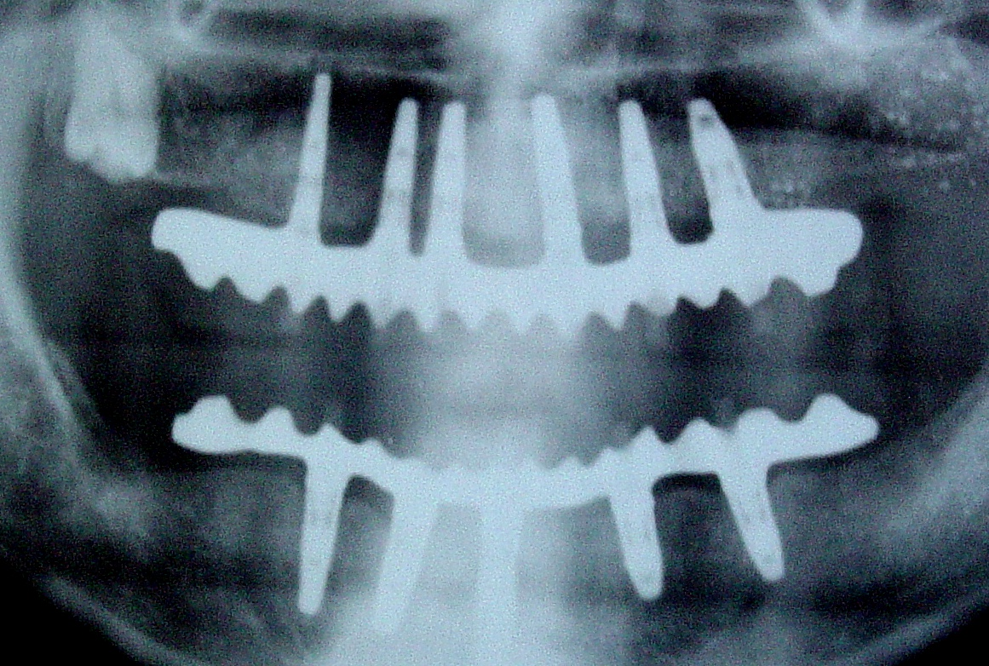
Opg after procera implant bridge

Slide 26
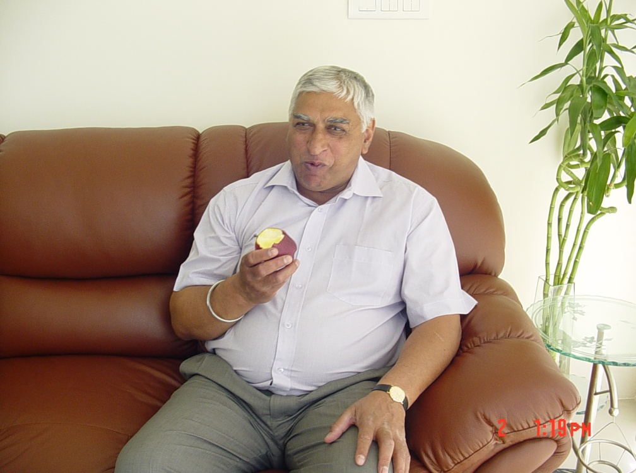
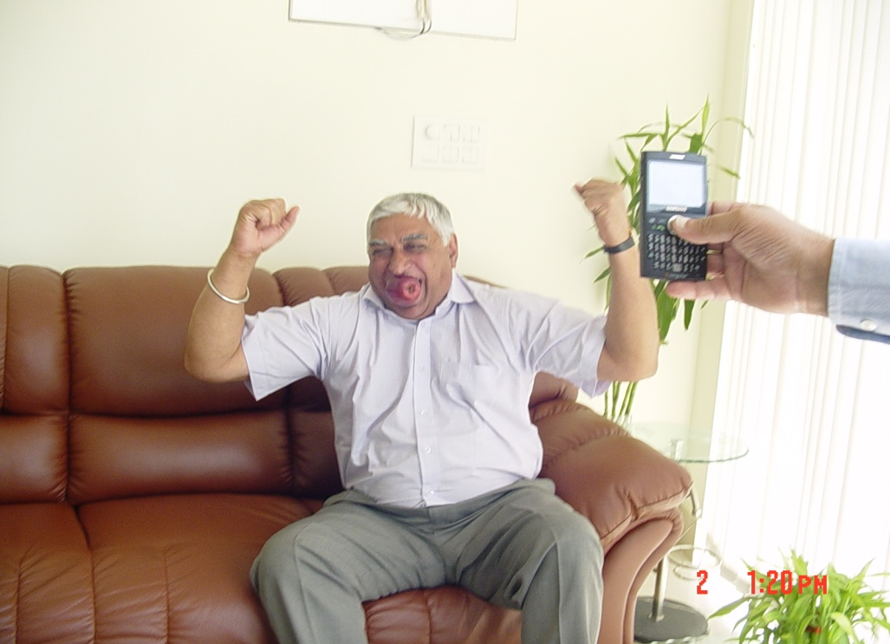
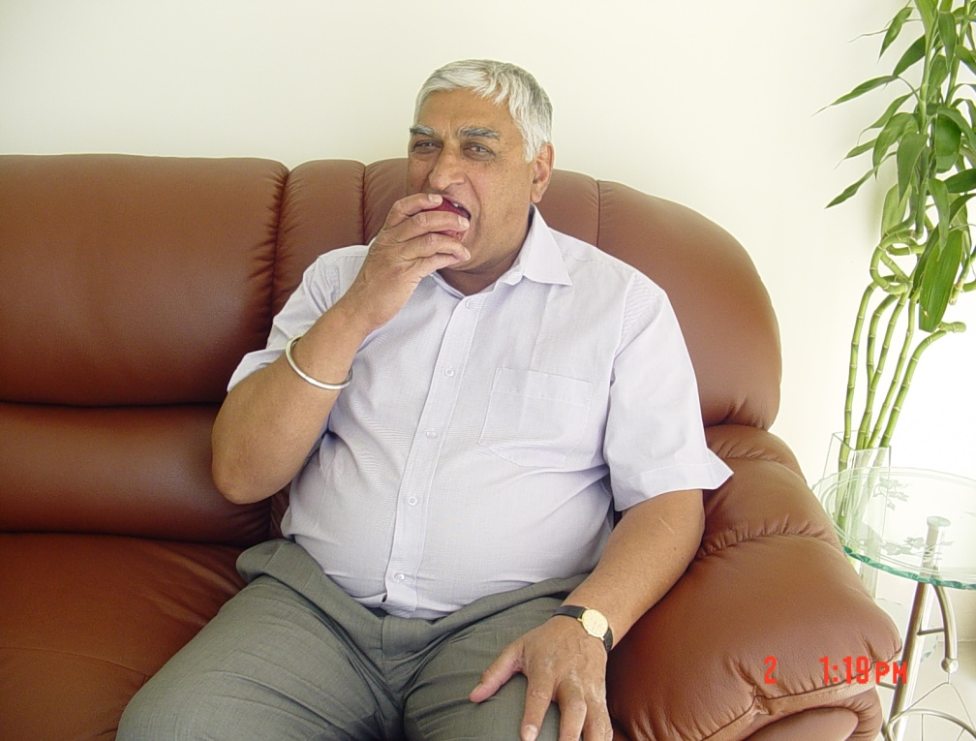
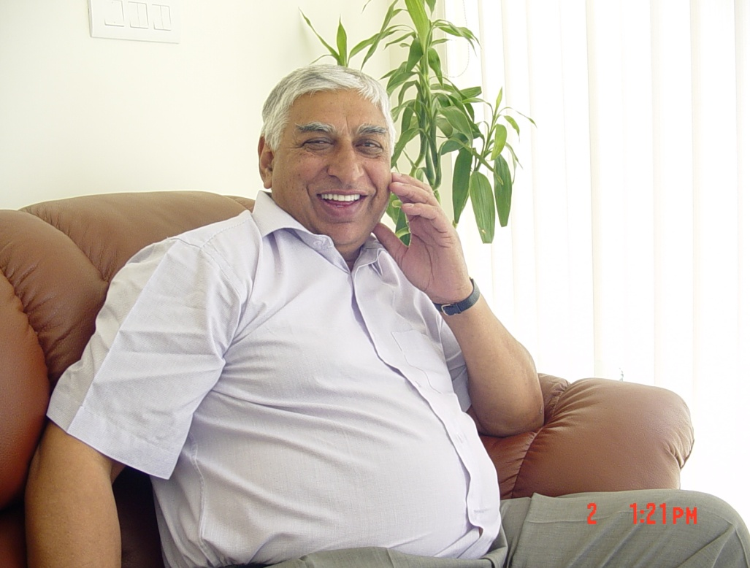
Eat what you want feel more comfortable

Slide 27
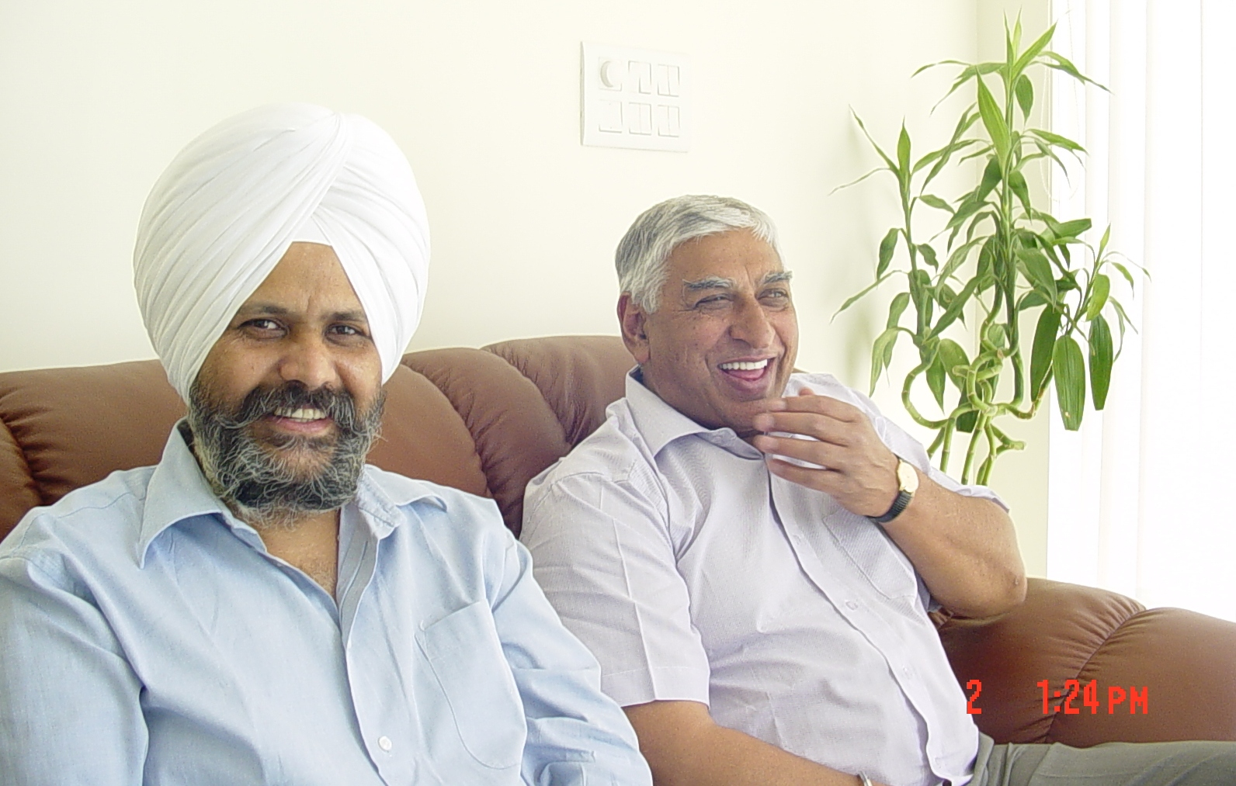
Happy Patient

Slide 28
Cheema dental implant centre and multi speciality dental clinic 213 model town jalandhar city punjab india. Ph:+919814603002 +919815603002

Slide 29
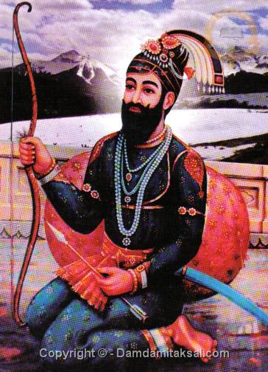
THANKS

